Slide 1
Big Data Frameworks
CSE3120
Dr. Sudharson S
Asst. Professor Sr
SCOPE

Slide 2
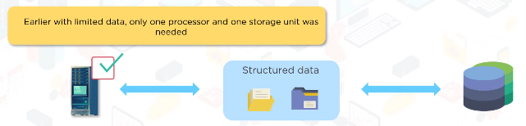
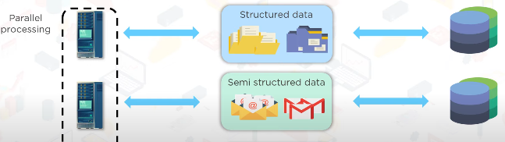
The rise of Big data
The rapid growth in the generation, collection, and analysis of vast amounts of data, driven by advancements in technology, and digitalization.

Slide 3
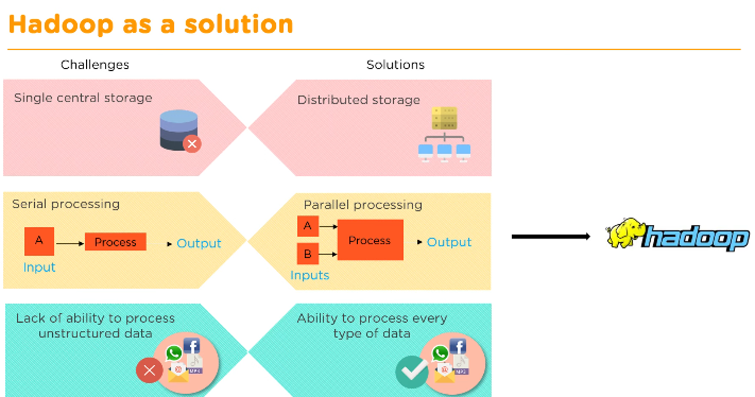
Solution
Challenges and solution for the big data problem

Slide 4
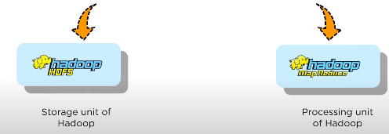
Hadoop
Hadoop is a software framework that manages big data storage in a distributed way and processes it in parallel.
Hadoop divides this data into smaller chunks, stores it on several computers, and processes it together. This way, you get results quickly and can make better business decisions.
Components of Hadoop

Slide 5
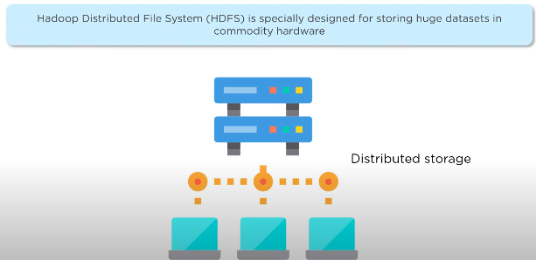
HDFS (Hadoop Distributed File System): Stores the data by dividing it across multiple computers.

Slide 6
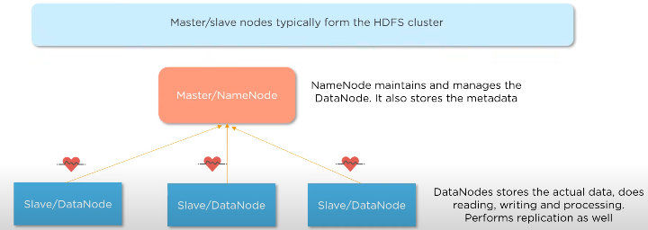
HDFS
HDFS (Hadoop Distributed File System): Components – NameNode and DataNode.
Data Storage:
NameNode: Does not store the actual data, only metadata. Example: File example.txt is divided into 3 blocks, stored on DataNodes X, Y, Z. NameNode tracks this mapping.
DataNode: Stores the actual data blocks. Example: DataNode X might store the first block of example.txt.

Slide 7
HDFS Commands
jps - Verify Hadoop services
mkdir: To create a directory
touchz: It creates an empty file
cat: To print file contents
cp: This command is used to copy files within hdfs.

